Slide 1

C L E A N CO D E
A H A N D B O O K O F A G I L E S O F T W A R E C R A F T S M A N S H I P
RO B E R T C . M A R T I N

Slide 2

CLEAN CODE
MEANINGFUL NAMES
FUNCTIONS
COMMENTS
FORMATTING
OBJECTS AND DATA STRUCTURES
ERROR HANDLING
UNIT TESTS
CLASSES
EMERGENCE
INDEX

Slide 3




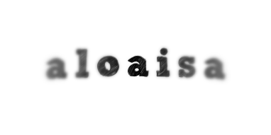






Q u i e n s o y
a l o a i s a

Slide 4
1
CLEAN CODE
C R A F T S M A N S H I P
There are two parts to learning craftsmanship: knowledge and work.

Slide 5


WANT
TO BE BETTER
“You are reading this book for two reasons. First, you are a programmer. Second, you want to be a better programmer. We need better programmers.”
RO B E R T C . M A R T I N

Slide 6

L
L E A R N & P R A C T I C E
It requires much time and effort, but we think it's worth.

Slide 7
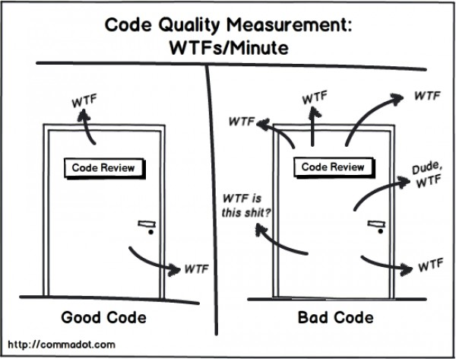
MEASUREMENT
CODE QUALITY
WTFs/minute

Slide 8

GOOD/BAD CODE
WHAT IS CLEAN CODE?
The main source of Bad Code are we, the programmers. We are not professionals.

Slide 9
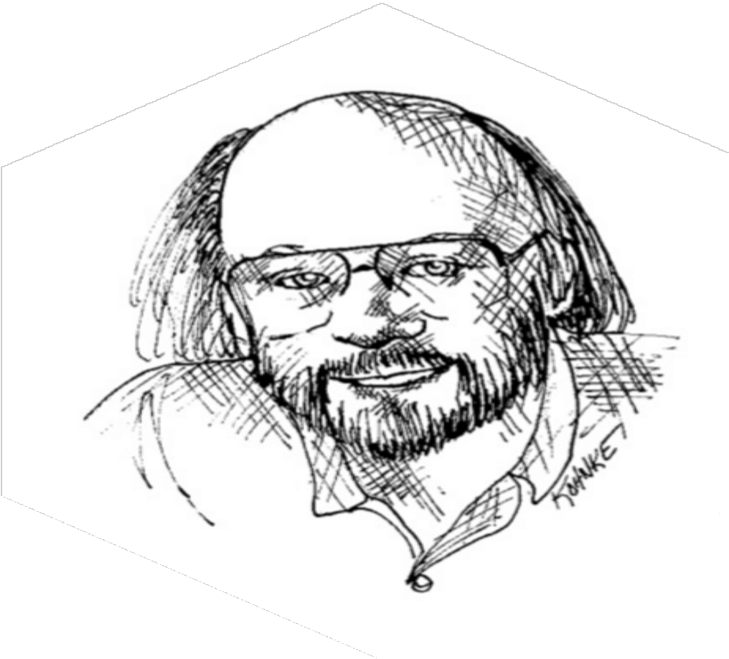
E L E G A N T
BJARNE STROUSTRUP
- I like my code to be elegante and eﬃcient
- Clean code does one thing well

Slide 10
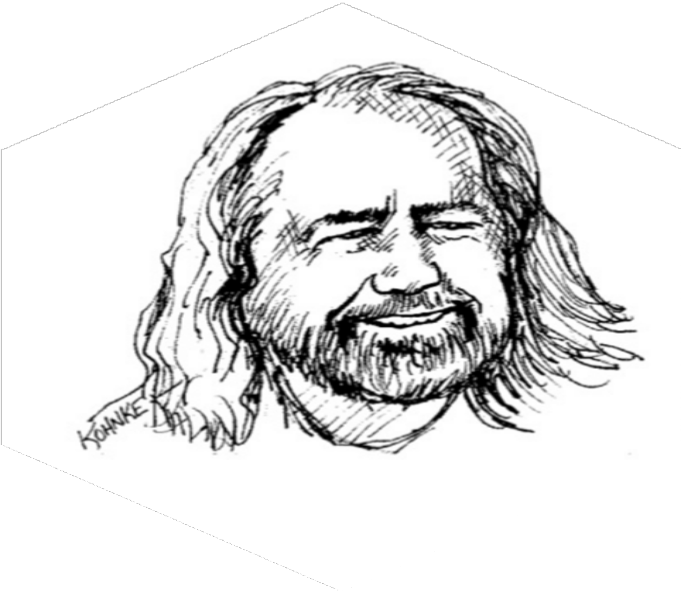
S I M P L E , D I R E C T , P R O S E
GRADY BOOCH
- Clean code is simple and direct
- Clean code reads like well-wriHen prose

Slide 11
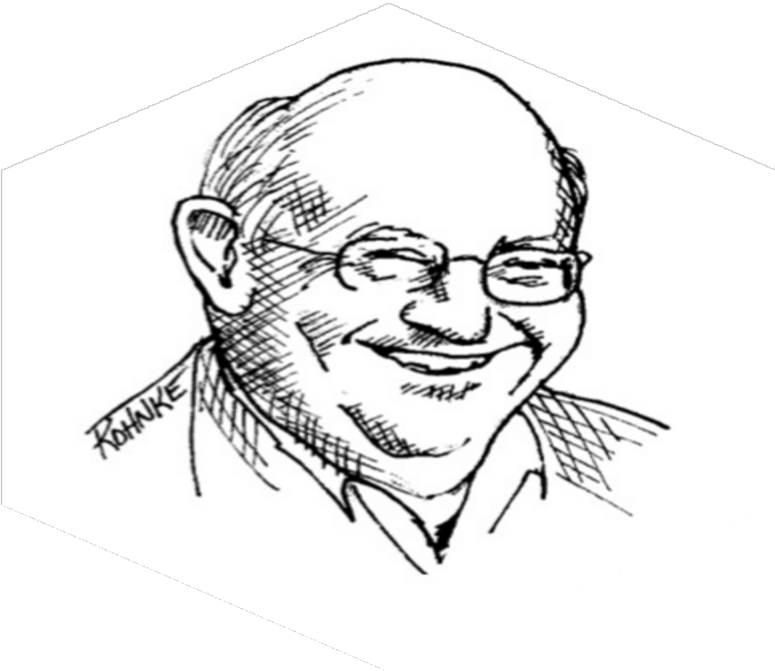
L I T E R A T E
DAVE THOMAS
- Clean code can be read
- Clean code shuold be literate

Slide 12
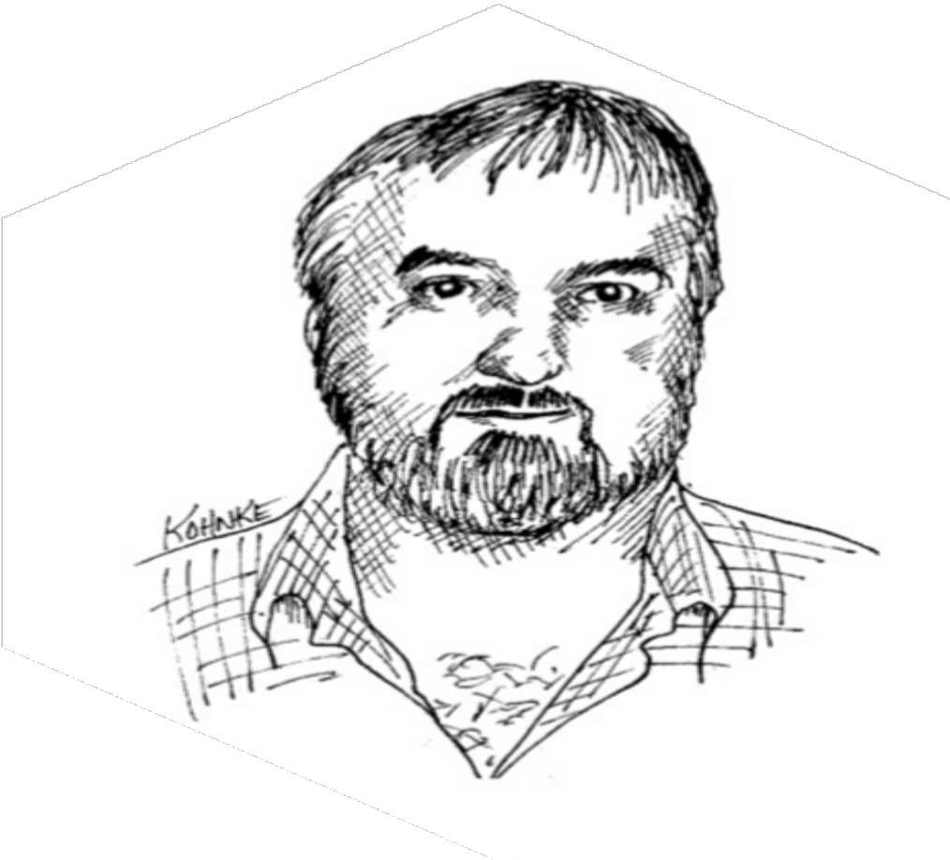
C A R E
MICHAEL FEATHERS
- Clean code always looks like it was wriHen by someone who cares

Slide 13
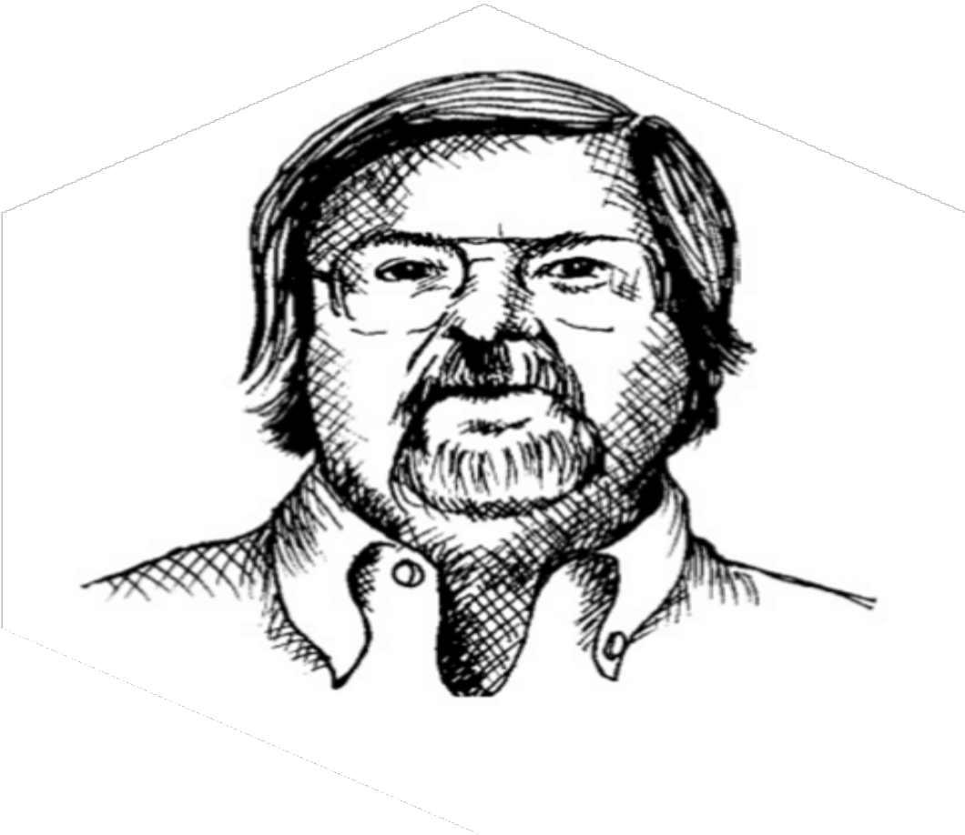
S M A L L , E X P R E S S I V E , S I M P L E
RON JEFFRIES
- Reduced duplicaJon, high expressiveness, and early building of simple abstracJons

Slide 14
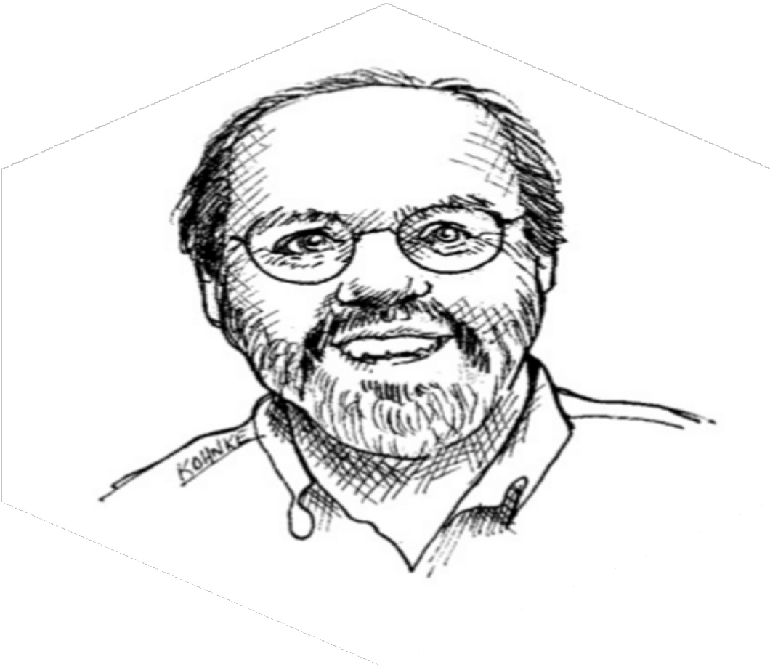
W H A T Y O U E X P E C T E D
WARD CUNNINGHAM
- You know you are working on clean code when each rouJne you reads turns out to be preHy much what you expected

Slide 15

ROBERT C. MARTIN
THE BOY SCOUT RULE
"Always leave the campground cleaner than you found it."
If you find a mess on the ground, you clean it up regardless of who
might have made the mess.
UNC LE BOB.

Slide 16




^{THE} BROKEN
T
WINDOW THEORY
Consider a building with a few broken windows. If the windows are not repaired, the tendency is for vandals to break a few more windows

Slide 17

W H Y ?
MONEY
THE COST OF THE BAD CODE
Time, Productivity, Stress and Proyects. All it’s about the Money $$$

Slide 18

BUT,
HOW DO WE DO IT ?
“Any fool can write code that a computer can understand.
Good programmers write code that humans can understand.”
MA R TI N F O WLER

Slide 19
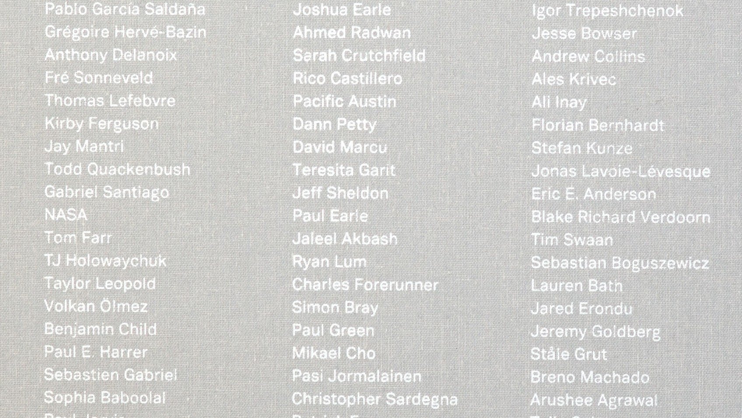
2
CLEAN CODE
M E A N I N G F U L N A M E S
In the code, the names are everywhere. Variables, Functions, Arguments, Classes and Packages, Directories and Files, Jars, Wars and Ears.

Slide 20
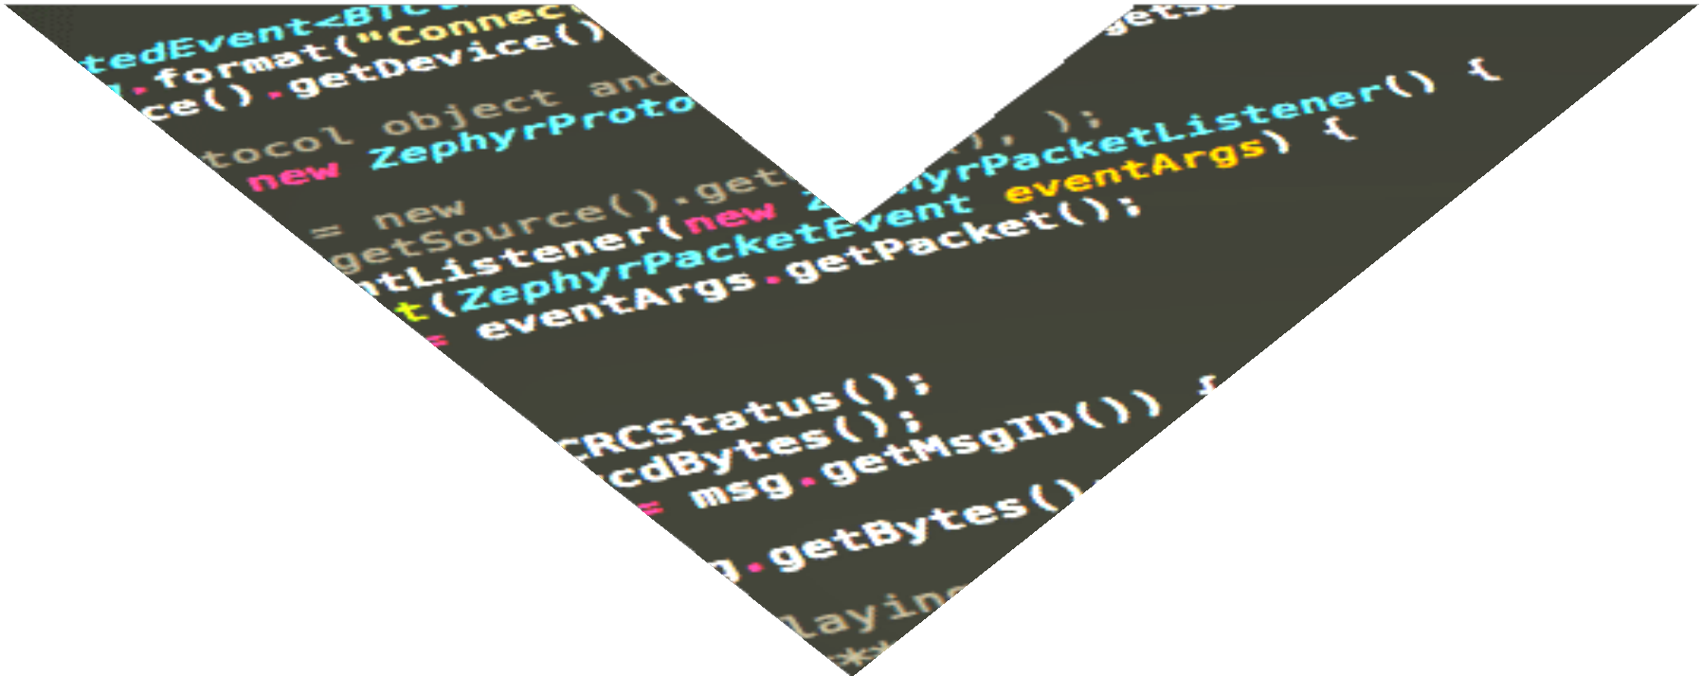

NAMING:
USE
INTENTION-REVEALING
NAMES
getLinearSearchPosition: -- indicates how the method works
getSearchPosition: -- is better
getPosition: -- is even better

Slide 21
NAMING:
AVOID
DISINFORMATION
int a = l; if (O == l)
a=O1;
else
l=01;

Slide 22
NAMING:
MAKE
MEANINGFUL
DISTINCTIONS
public static void copyChars(Char a1[], Char a2[]) { for (int i = 0; i < a1.length; i++) {
a2[i] = a1[i];
}
}

Slide 23

NAMING:
class DtaCrc {
private Date genymdhms;
…
PhoneNumber phoneString;
// name not changed when type changed!
class Customer {
private Date generationTimestamp;
…
PRONOUNCEABLE NAMES
SEARCHEABLE
HUNGARIAN NOTATION
MEMBER PREFIXES
int realTaskWeeks =
(realDays / WORK_DAYS_PER_WEEK)
public class Part {
private String m_dsc;
void setName(String name) { m_dsc = name;
}
}

Slide 24
NAMING:
postpayment, deletePage, save, …
// methods should have verb or verb phrase names
String name = employee.getName(); customer.setName(“Alvaro”);
if (paycheck.isPosted())…
for (a = 0; a < 10; a++)
for (b = 0; b < 10; b++)
…
Complex complex = Complex.fromRealNumber(23.0);
// is generally better than
Complex complex = new Complex(23.0);
for (i = 0; i < 10; i++)
for (j = 0; j < 10; j++)
…
AVOID MENTAL MAPPING
CLASS NAMES
METHOD NAMES
PICK ONE WORD PER CONCEPT
Manager, Processor, Data, Info
// a class name should not be a verb
fetch, retrieve, get //As equivalen methods
controller, manager, driver //Confusing
Customer, WikiPage, Account, AddressParser

Slide 25
NAMING:
USE
DOMAIN NAMES
AccountVisitor, JobQueue
// people who read you code will be programmers
// Don't Add Gratuitous Context class Address {
private String nameAddress;
…

Slide 26

3
CLEAN CODE
F U N C T I O N S
The first rule of functions is that they should be small.
The second rule of functions is that they should be smaller than that.

Slide 27



FUNCTIONS:
DO
ONE THING
Functions should do one thing. They should do it well. They should do it only.
// < 150 CARACTERES PER LINE
// < 20 LINES

Slide 28
FUNCTIONS:
class Employee…
int payAmount() {
class EmployeeType…
abstract int payAmount() {
// high level of abstraction getHTML();
switch (getType()) {
case EmployeeType.ENGENIEER: return salary;
class Engenieer extends EmployeeType… int payAmount() {
return salary;
}
// intermediate level of abstraction
String pagePathName = PathParse.render(pagePath);
case EmployeeType.MANAGER: return salary + bonus;
…
class Manager extends EmployeeType… int payAmount() {
return salar + bonus;
}
// remarkably low level message.append(“\n”);
ONE LEVEL OF ABSTRACTION
THE STEPDOWN RULE
SWITCH STATEMENTS
USE DESCRIPTIVE NAMES
// Don’t be afraid to make a name long.
// A long descriptive name is better than a
// short enigmatic one.
// Reading Code from Top to Bottom
// we want the code to read like a
// top-down narrative
// Experiment with names to find the
// ones that clarify the design of your
// module

Slide 29
FUNCTIONS:
ARGUMENTS
writeField(name);
// is easier to understand than
writeField(outputStream, name);
// perfectly reasonable
Point point = new Point(0, 0);
// if a función is going to transform its input argument
// the transformation shuold appear as the return value
// problematic
assertEquals(expected, actual);
assertEquals(message, expected, actual);
InputStream openFile = fileOpen(“My File”);
COMMON MONADIC FORM
FLAG ARGUMENTS
DYADIC/TRIAD FUNCTIONS
ARGUMENT OBJECTS
render(true);
Circle makeCircle(double x, double y,
double radius);
renderForSuite();
renderForSingleTest();
Circle makeCircle(Point center,
double radius);

Slide 30
FUNCTIONS:
Functions should:
do something (change the state of an object) — a command
return something (return some information about that object) — a query
write(name);
writeField(name);
but not do both, as doing both often leads to confusion.
assertEquals(expected, actual);
assertExpectedEqualsActual(expected, actual);
The solution is to separate the command from the query, by creating two functions from the one that did two things.
VERBS AND KEYWORDS
HAVE NO SIDE EFFECTS
COMMAND QUERY SEPARATION
OUTPUT ARGUMENTS
public boolean checkPassword(User user, String password) { String codedPhrase = user.getPhraseEncodedByPassword(); if (cryptographer.decrypt(codedPhrase, password)) {
Session.initialize(); return true;
}
return false;
}
// In general output arguments should
// be avoided.
// If your function must change the state
// of something, have it change the state
// of its owning object.

Slide 31

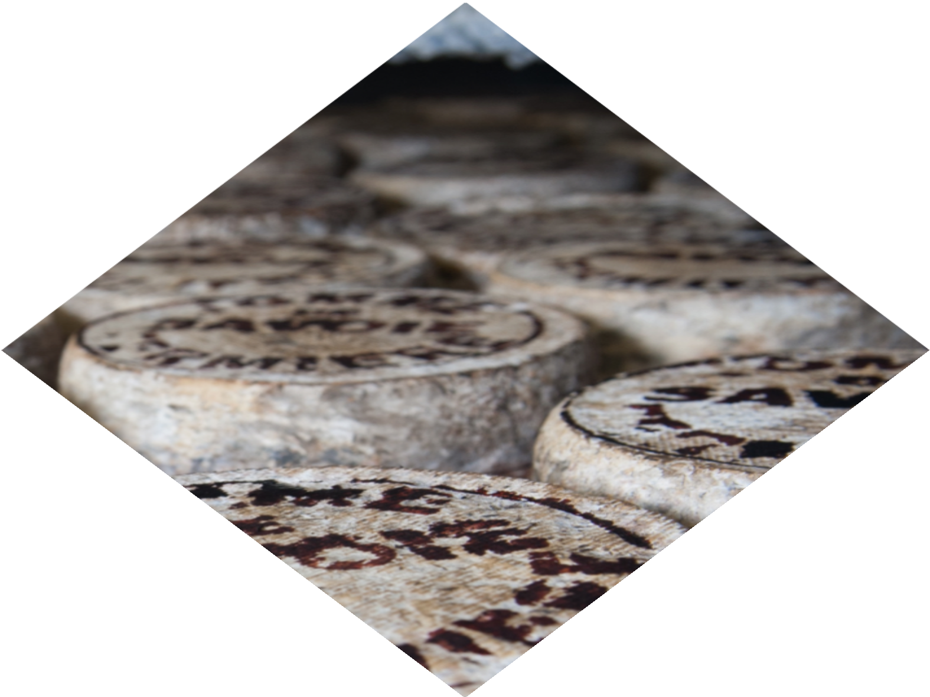
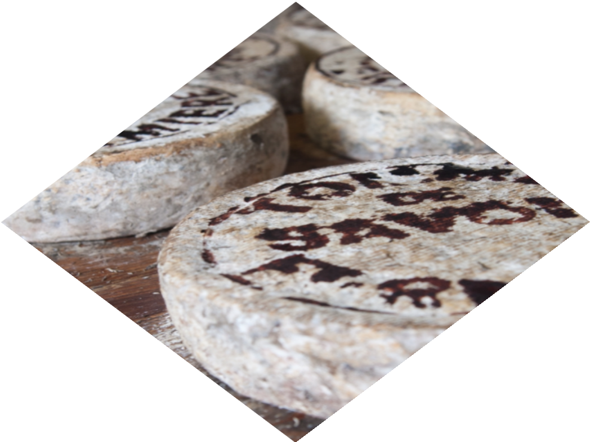
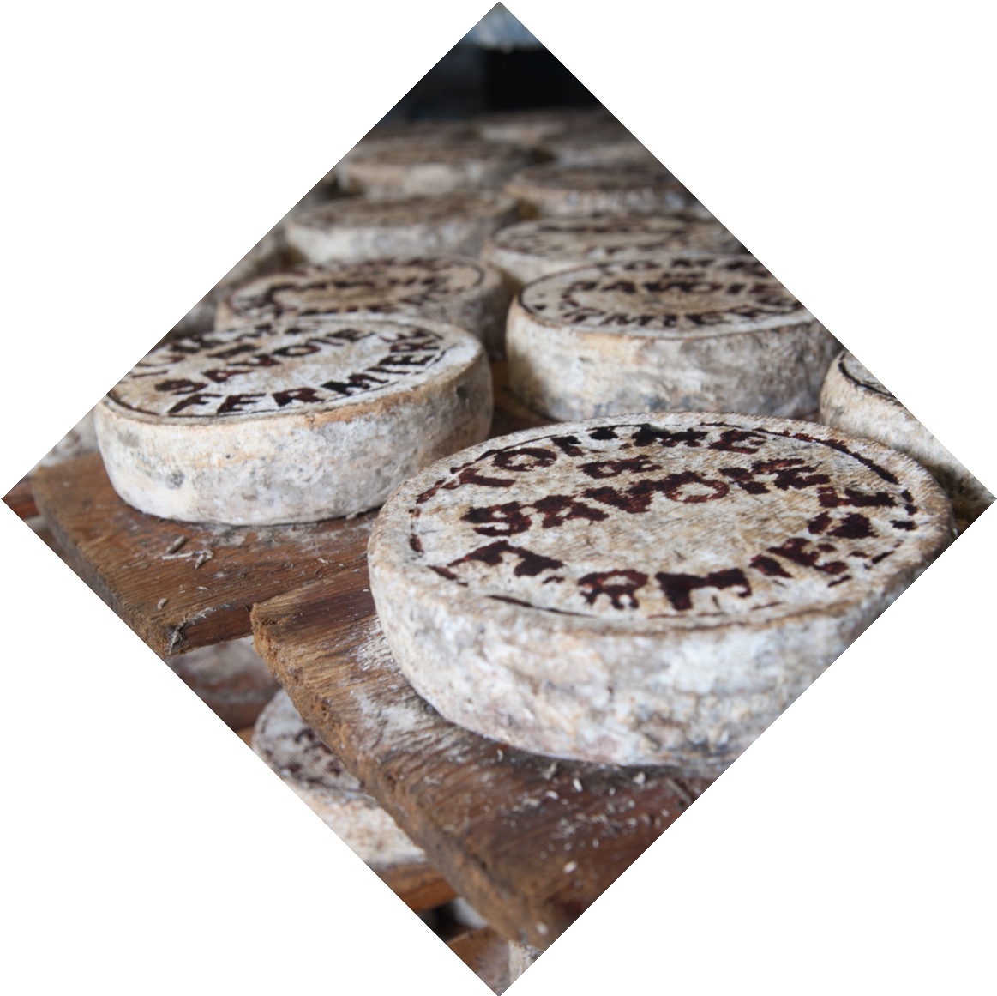
FUNCTIONS:
DRY
DON'T REPEAT YOURSELF
D
DRY
Duplicaction may be the root of all evil in software

Slide 32
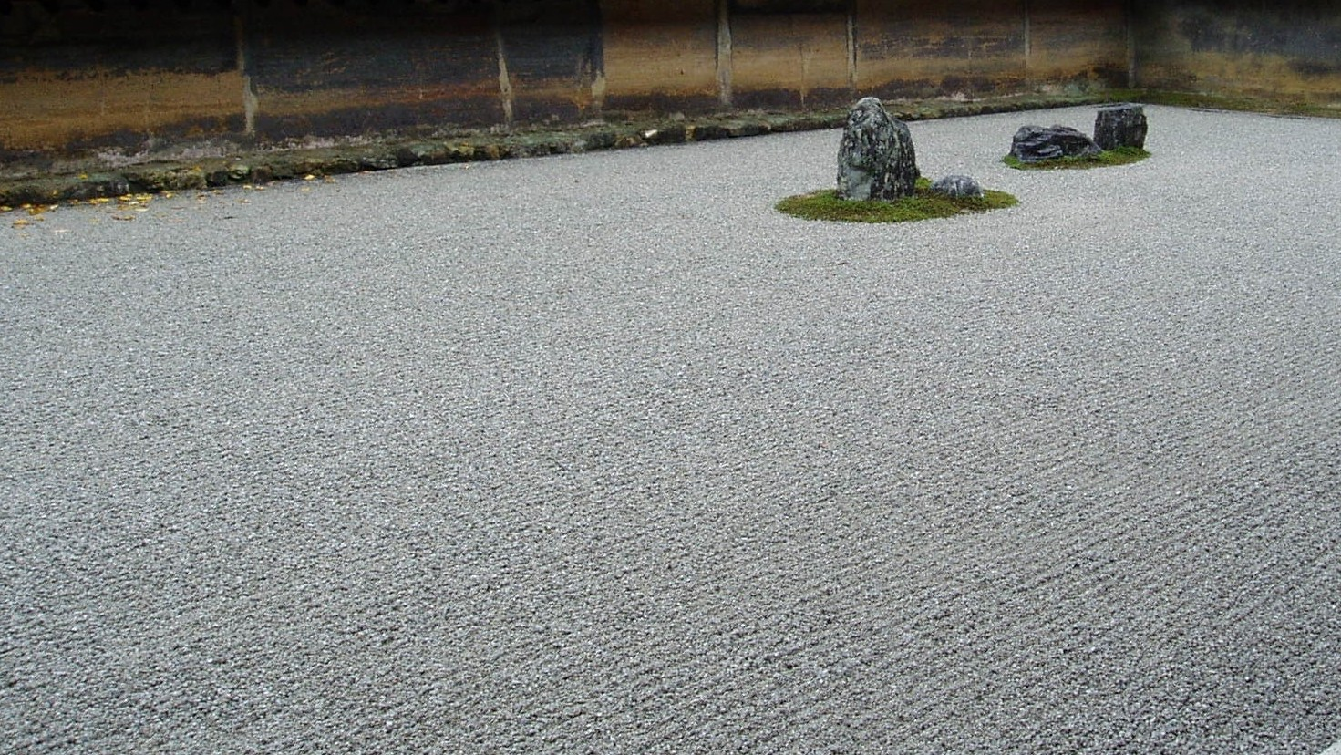
KISS
K I S S
KEEP IT SIMPLE, STUPID

Slide 33

4
CLEAN CODE
C O M M E N T S
Comments Do Not Make Up for Bad Code
Don't comment bad code, rewrite it!
Explain Yourself in Code

Slide 34
COMMENTS:
GOOD
/************************************
* Copyright (C) 2010-2011 {name} <{email}>
*
* This file is part of {project}.
// This is our best attempt to get a race condition
// by creating large number of threads. for (int i = 0; i < 25000; i++) {
Thread….
*
{project} can not be copied and/or distributed
without the express permission of {name}
*************************************/
LEGAL COMMENTS
INFORMATIVE COMMENTS
EXPLANATION OF INTENT
CLARIFICATION
// return an instance of the Response being tested
Protected abstract Responder responderInstance();
assertTrue(a.compareTo(b == -1)); // a < b assertTrue(b.compareTo(a == 1)); // b > a
// Format matched kk:mm:ss EEE, MMM dd, yyyy Pattern tomeMatcher = Pattern.compile(
“\\d*:\\d*:\\d* \\w*, \\w* \\d*, \\d*”);

Slide 35
COMMENTS:
GOOD
public static SimpleDateFormat makeStandardHttpDateFormat() {
// SimpleDateFormat is not thread safe,
// so we need to create each instance independently
SimpleDateFormat df = new SimpleDateFormat(‘dd MM yyyy’); df.setTimeZone(TimeZone.getTimeZone(“GMT”));
return df;
}
String listItemContent = match.group(3).trim();
// the trim is real important. It removes the starting
// spaces that could cause the item to be recognized
// as another list.
…
WAITING OF CONSEQUENCES
TODO COMMENTS
AMPLIFICATION
JAVADOCS IN PUBLIC APIS
// TODO We need to test this class
// and controll the Exceptions
Only in publics APIs!

Slide 36
COMMENTS:
BAD
try {
String propertiesPath = propertiesLocation + “\” + PROPERTIES;
FileInputStream properties = new FileInputStream(propertiesPath); loadedProperties.load(properties);
} catch () {
// No properties files means all default are loaded
}
// The Processor delay for this component
protected int backgroundProcessorDelay = -1;
// The lifecycle event support for this component protected LifecycleSupport lifecycle = new …
// The container event list for this Container
protected ArrayList eventList = new ArrayList();
REDUNDANT COMMENTS
MISLEADING COMMENTS
MANDATED COMMENTS
MUMBLING
/**
@param title The title of the CD
@param author The author of the CD
@param tracks The tracks of the CD
**/
public void addCD(String title,
String author, int tracks) {
…
// Utility method that returns when this.closed is true.
// Throws an exception if the timeout is reached. public synchronized void waitForClose(
final long timeoutMillis) throws Exception {
….

Slide 37
COMMENTS:
BAD
/**********************************************
* commit ca82a6dff817ec66f44342007202690a93763949
Author: Scott Chacon <schacon@gee-mail.com>
Date: Mon Mar 17 21:52:11 2008 -0700
/** The name */
private String name;
/** The version */
private String version;
*
* changed the version number
NOISE COMMENTS
SCARY NOISE
DON’T USE A COMMENT
JOURNAL COMMENTS
/**
* Default constructor
**/
protected AnnualDateRule() {}
// Don’t Use a Comment When You Can
// use a Function or a Variable
// The day of the month private int dayOfMonth;

Slide 38
COMMENTS:
BAD
// Private Methods /////////////////////////////////
/**Added by Rick **/
POSITION MAKERS
CLOSING BRACE COMMENTS
ATTRIBUTIONS AND BYLINES
COMMENTED-OUT CODE
String name = person.getName();
// String name = “text”;
// loadedProperties.load(properties);
while (message.isPresent()) {
…
} // while

Slide 39
COMMENTS:
BAD
/**
<p>Here are my notes and favourite from chapter 4,
“Comments”, of one of my all-time favourite books:
<em>
<a href="..." target="_blank">Clean Code: A Handbook of Agile Software Craftsmanship</a>
</em>, by Robert C. Martin.</p>
/**
SIP is based on an HTTP-like request/response transaction model.
Each transaction consists of a request that invokes a particular
method, or function, on the server and at least one response. In
this example, the transaction begins with Alice's softphone sending
an INVITE request addressed to Bob's SIP URI. INVITE is an example
of a SIP method that specifies the action that the requestor (Alice)
wants the server (Bob) to take. The INVITE request contains a
of header fields. Header fields are named attributes that provide
additional information about a message. The ones present in an
INVITE include a unique identifier for the call, the destination
HTML COMMENTS
NONLOCAL INFORMATION
TOO MUCH INFORMATION
INOBVIOUS CONNECTION
/**
* start with an array that is big enough to hold
all the pixel (plus filtre bytes), and an extra
200 bytes for header info
*/
this.pngBytes = new byte[(
(this.width + 1) * this.height * 3)
+ 200];
/**
Port on with fitnesse would run.
Default to <b>8082</b>.
*/
public void setFitnessePort(int port)

Slide 40

S H O R T
FUNCTION HEADERS
SHORT FUNCTIONS DON’T NEED MUCH DESCRIPTION

Slide 41


FORMATTING
5
CLEAN CODE
THE PURPOSE OF F ORM ATTI NG IS C O M M U N IC AT IO N
First of all, let's be clear. Code formatting is important.

Slide 42
FORMATTING:
VERTICAL
// Variables
// should be declared as close to their usage as possible
// instance variables
// should be declared at the top of the class
// dependent functions
// if one function calls another, they should be vertically
// close, and the caller should be above the called
// conceptual affinity
// certain bits of code want to be near other bits
// each blank line is a visual cue
// that identifies a new and separate concept
// another concept…
VERTICAL OPENNESS BETWEEN CONCEPTS
VERTICAL DENSITY
VERTICAL DISTANCE
THE NEWSPAPER METAPHOR
// Vertical density implies close association
/**
the class name of the reportar listener
*/
private String m_className;
/**
the properties of the reporter listener
*/
private m_properties = new ArrayList();
// high-level —> details

Slide 43
FORMATTING:
public class FitNesseServer implements SocketServer { private FitNesseContext context;
public FitNesseServer(FitNesseContext context) { this.context = context; }
public void serve(Socket s) { serve(s, 10000); }
public void serve(Socket s, long requestTimeout) { try { FitNesseExpediter sender = new
FitNesseExpediter(s, context);
sender.setRequestParsingTimeLimit(requestTimeout); sender.start(); }
catch(Exception e) { e.printStackTrace(); } }
}
HORIZONTAL
public void PersistLogicResultToTheDataAccessObject() { Query query = new Query();
Result result = new Result();
when(businessLogic.handle(query)).thenReturn(result); Response response = controller.doSomethingWith(query); assertThat(response.status(), is(OK));
verify(dataAccessObject.persist(result));
}
HORIZONTAL OPENNESS AND DENSITY
HORIZONTAL ALIGNMENT
BREAKING INDENTATION
TEAM RULES
public FitNesseExpediter(Socket s,
FitNesseContext context) throws Exception {
// Every Programmer has his own
// favourite formatting rules.
// But if he works in a team
// then the team rules
this.context socket
input output
= context;
= s;
= s.getInputStream();
= s.getOutputStream();
requestParsingTimeLimit = 10000;
}

Slide 44

6
CLEAN CODE
O B J E C T S A N D
D A T A S T R U C T U R E S

Slide 45
DATA STRUCTURE:
OBJECTS
public interface Vehicle {
double getFuelTankCapacityInGallons();
double getGallonsOfGasoline();
// objects hide their data behind abstractions and
// expose functions that operate on that data
}
public interface Vehicle {
double getPercentFuelRemaining();
}
// data structure expose their data and
// have no meaningful functions
DATA ABSTRACTION
TRAIN WRECKS
DATA/OBJECT ANTI-SYMMETRY
THE LAW OF DEMETER
Options opts = ctxt.getOptions();
File scratchDir = opts.getScratchDir();
final String outputDir = scratchDir.getAbsolutePath();
// a module should not know about the
// innards of the objects it manipulates.
final String outputDir = ctxt.getOptions()
.getScratchDir()
.getAbsolutePath();

Slide 46

7
CLEAN CODE
E R R O R H A N D L I N G
Things can go wrong, and when they do, we as programmers
are responsible for making sure that our code does what it needs to do.

Slide 47

ERROR
HANDLING
USE EXCEPTIONS RATHER THAN RETURN CODES
if (deletePage(page) == E_OK) {
if (registry.deleteReference(page.name) == E_OK) {
if (configKeys.deleteKey(page.name.makeKey()) == E_OK){ logger.log("page deleted");
} else {
logger.log("configKey not deleted");
}
} else {
logger.log("deleteReference from registry failed");
}
} else {
logger.log("delete failed"); return E_ERROR;
}
E X C E P T I O N S
try {
deletePage(page);
registry.deleteReference(page.name);
configKeys.deleteKey(page.name.makeKey());
} catch (Exception e) {
logger.log(e.getMessage());
}

Slide 48

EXTRACT
TRY/CATCH
BLOCKS
public void delete(Page page) { try {
deletePageAndAllReferences(page);
}
catch (Exception e) { logError(e);
}
}
private void deletePageAndAllReferences(Page page)
throws Exception { deletePage(page);
registry.deleteReference(page.name);
configKeys.deleteKey(page.name.makeKey());
}
private void logError(Exception e) { logger.log(e.getMessage());
}

Slide 49
ERROR:
HANDLING
List<Employee> employees = getEmployees(); if (employees != null) {
for(Employee e : employees) { totalPay += e.getPay();
}
}
List<Employee> employees = getEmployees(); for(Employee e : employees) {
totalPay += e.getPay();
}
public List<Employee> getEmployees() { if ( .. there are no employees .. )
return Collections.emptyList();
}
// Functions should do one thing.
// Error handing is one thing.
ERROR HANDLING IS ONE THING
DEFINE THE NORMAL FLOW
DON'T RETURN NULL
DON'T PASS NULL
try {
MealExpenses expenses = expenseReportDAO
.getMeals(employee.getID()); m_total += expenses.getTotal();
} catch(MealExpensesNotFound e) { m_total += getMealPerDiem();
}
calculator.xProjection(null, new Point(12, 13));

Slide 50

UNIT TESTS
8
CLEAN CODE
ONC E I GOT A SUI TE OF TEST S T O PA SS, I W OULD MA KE SURE TH AT THOSE TEST S WERE C ONV ENI ENT TO R U N F O R A N YO N E E L S E W H O NEEDED T O W ORK WI TH THE C ODE.

Slide 51



THE THREE LAWS OF TDD:
YOU MAY NOT WRITE…
producJon code unJl you have wriHen a failing unit test.
YOU MAY NOT WRITE…
more of a unit test than is suﬃcient to fail, and not compiling is failing.
YOU MAY NOT WRITE…
more producJon code than is suﬃcient to pass the currently

Slide 52
UNIT TESTS:
// the best rule is that you should
// minimize the number of asserts per concept and
// test just one concept per test function
// test code is just as important as production code
KEEPING TEST CLEAN
CLEAN TESTS
SINGLE CONCEPT PER TEST
ONE ASSERT PER TEST
// what makes a clean test? three things
// readability, readability, and readability
// tests come to a single conclusión
// that is quick and easy to understand

Slide 53





F I R S T
FAST
INDEPENDENT
REPEATABLE
SELF-VALIDATING
TIMELY
Tests should be fast. They should run quickly
Tests should not depend on each other. One test should not set up the condiJons
Tests should be repeatable in any environment.
The tests should have a boolean output. Either they pass or fail.
The tests need to be wriHen in a Jmely fashion.

Slide 54

9
CLEAN CODE
C L A S S E S

Slide 55
CLASS:
// public static constants
// private static variables
// private instance variables
// public functions
// private utilities called by a public function right after
// a class or module should have one, and only one,
// reason to change and only one responsibility
// SRP is one of the more important concept in OO design
CLASS ORGANIZATION
SHOULD BE SMALL!
THE SINGLE RESPONSIBILITY PRINCIPLE
COHESION
// the first rule is that they should be small
// the second rule is that they should be smaller
// than that
// maintaining cohesion results in
// many small classes

Slide 56
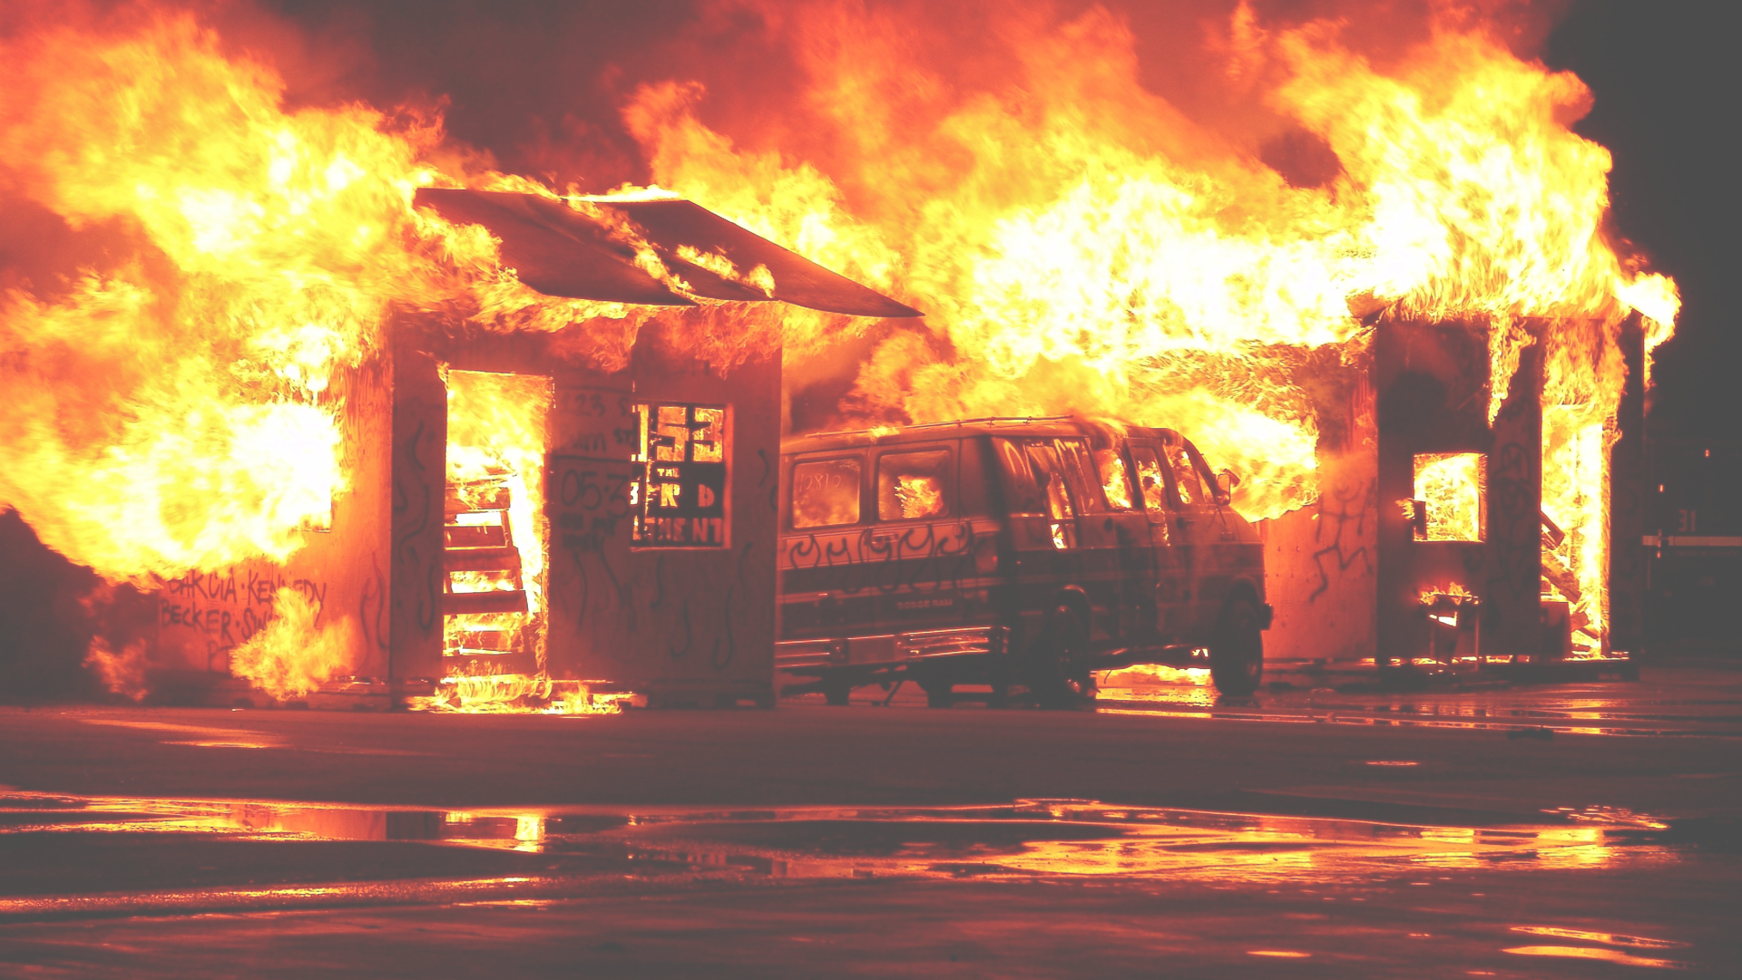
10
CLEAN CODE
E M E R G E N C E !

Slide 57
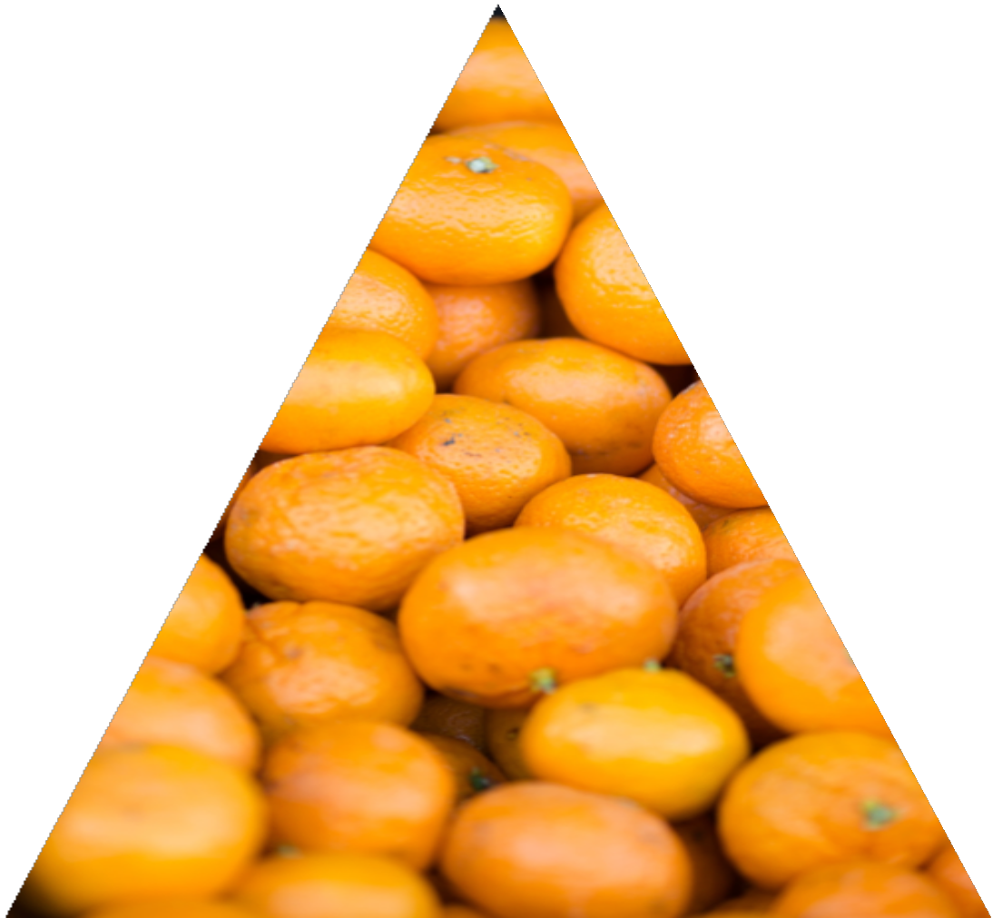



SIMPLE DESIGN
KENT BECK’S FOUR RULES OF
NO DUPLICATION ₂
₃ EXPRESSIVE
RUNS ALL THE TESTS 1
4
MINIMAL CLASSES AND METHODS

Slide 58
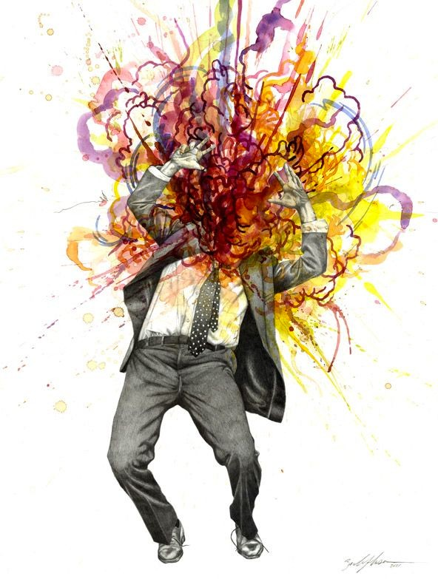
E N D

Slide 59
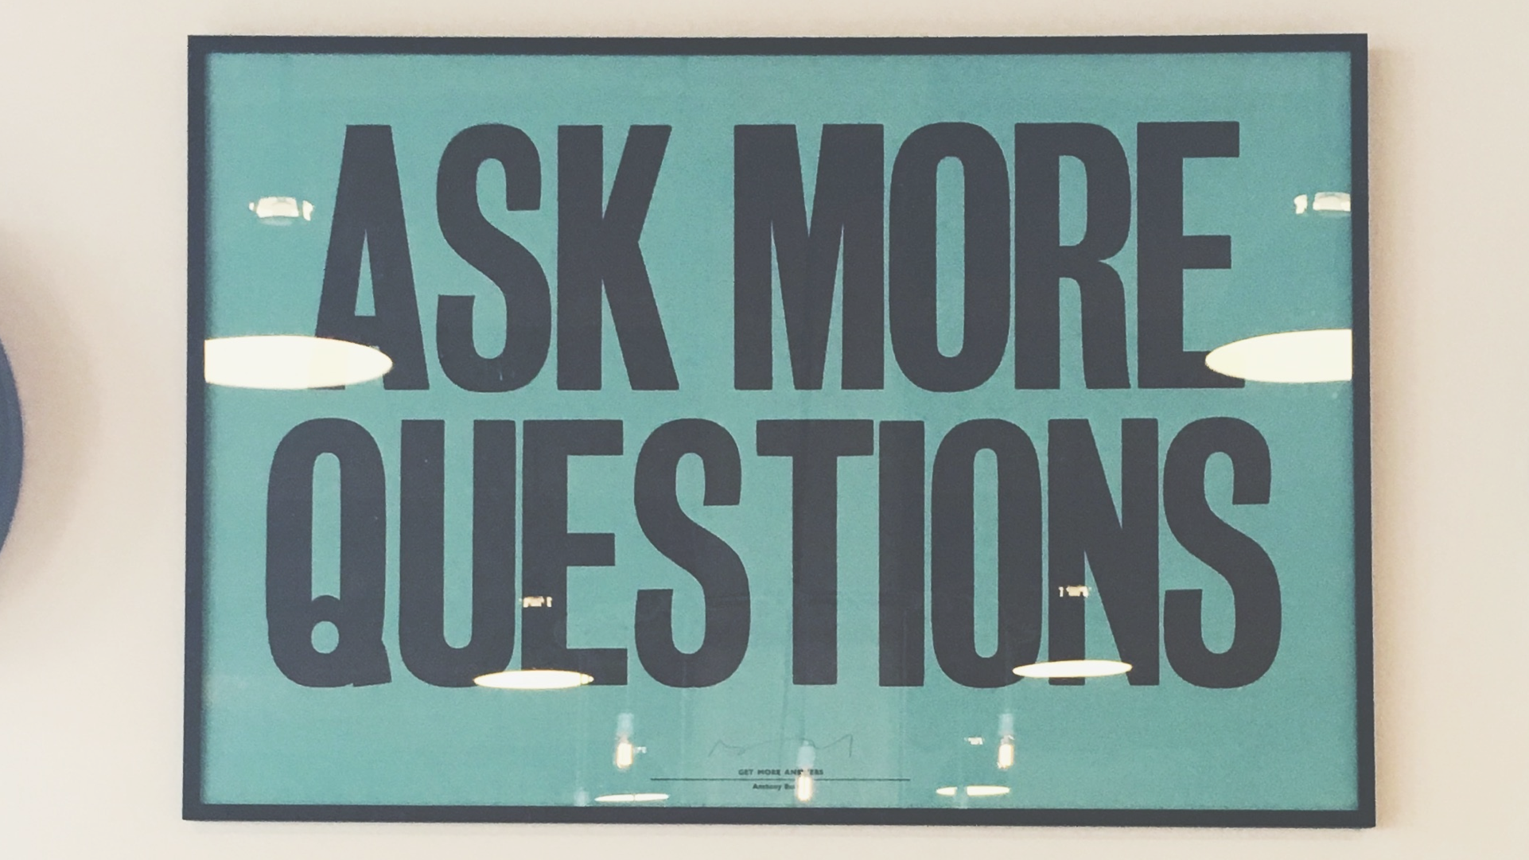

Slide 60


